Slide 1
UNIT-II
LOGIC FAMILIES

Slide 2
Emitter-Coupled Logic (ECL)
Non saturated digital logic family & Used in high speed circuits
Propagation rate as low as 1-2ns
Noise immunity and power dissipation is high compare of all logic families.
Including
Differential input amplifier
Internal temperature and voltage compensated bias network
Emitter-follower outputs
Notes:
2

Slide 3
ECL NOR / OR
The circuit has 2 outputs- inverting and non inverting output, input low is 3.6 V, input high is 4.4V.
When A=B=0, so Q1, Q2 are OFF, then Out1=High and Out2=Low.
When A=B=1, so Q1, Q2 are ON, then Out1= low and Out2=High.

Slide 4
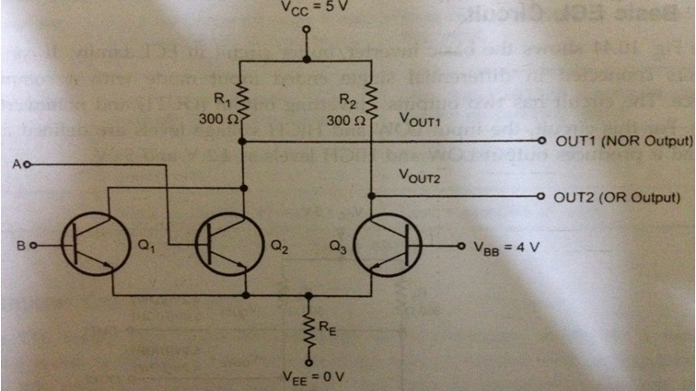
ECL (NOR/OR GATE)

Slide 5
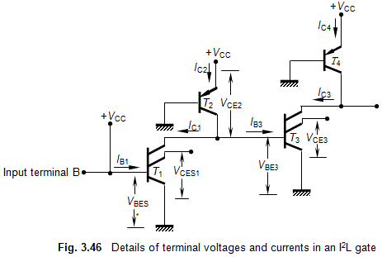
Operating Principles of I²L gates
Integrated Injection Logic Operation is explained as follows. To understand the working of a typical I²L gate, consider the figure, which consists of five transistors, connected as shown.
It can be seen that the base current I_{B1} of T₁ is derived from +V_{CC} through the input terminal B. The base-bias current I_{B3} of transistor T₃ and the collector current I_{C1} of T₁ are obtained from the collector current of transistor T₂ whose injector (emitter) also is connected to +V_{CC}.

Slide 6
If I_{B1} is sufficient, the base-to-emitter voltage V_{BE1} of T₁ will become the saturation base-emitter voltage V_{BES1} (= 0.8 volt), and in this condition, its collector-to-emitter voltage V_{CE1} will become saturation base-emitter voltage V_{CES1} (= 0.2 volt).
So, we find that T₁ is in the ON-state and its output is at logic-0 level. Since V_{CES1} = 0.2 volt, the collector current I_{C2} of T₂ will flow through the collector of T₁ as I_{C1}, and V_{BE3} of T₃ = 0.2 V = V_{CES1}.
This means that at this moment, T₃ is OFF and its collector-emitter voltage V_{CE3} = 0.8 volt. Now, let the input voltage V_{i} = 0 V. This makes transistor T₁ to be in OFF-state, and I_{C2} to flow through the base of T₂.
Thus, V_{BE3} = V_{BES3} = 0.8 V. This makes V_{CE1} = V_{BES3} = logic 1, and V_{CE3} = V_{CES3} = logic 0.
Thus, the transistors perform inversion operation, with logic 0 = V_{CES} = 0.2 V, and logic 1 = V_{BES} = 0.8 V. The voltage swing of this gate, therefore, is V_{swing}=V_{BES} – V_{CES} = 0.8 – 0.2 = 0.6 volt
It can be seen that the logic swing of I²L gates is very low and this is a major defect of these gates.

Slide 7
Advantages of I²L Gates
Since I²L gates are made up only of BJTs, they possess high speed of operation. Because only transistors are used for the construction, I²L gates have high packing density, and are hence suitable for construction of VLSI circuits.
· Very low power-supply requirement (1 volt) .
· Low power dissipation
.
· Number of processing steps required is small; hence cost per gate is low.
· Several functions are possible on the same chip.
· Using bipolar technology, it is possible to combine I²L gates with other logic families.

Slide 8
Disadvantages of I²L Gates
Very low voltage swing (≈ 0.6 V); the swing is between V_{BES} (0.8 V) and V_{CES} (0.2 V).
· Lower packing density than NMOS.
· Lower noise margin.
· External resistance required for proper functioning.
· I²L technology, at present, is dormant.

